Slide 1
HA TECHNOLOGY

Slide 2



Slide 3
Company History
2017-2018: Building Foundations
Established as a tech solutions provider in 2017.
Laid the groundwork for a client-centric approach.
2. 2019-2020: Diverse Industry Impact
Executed projects across various industries.
Gained reputation for reliability and efficiency.
3. 2021-2022: Focus on Education Technology
Shifted focus to education sector.
Developed applications for enhanced learning experiences.
4. 2023-Present: Innovation and Excellence
Continued commitment to staying ahead of industry trends.
Successfully delivered cutting-edge solutions.

Slide 4
PROject history

Slide 5

E-Commerce Platform Developed a robust e-commerce solution for seamless online transactions Resulted in a 30% increase in client's online sales within the first quarter

Slide 6

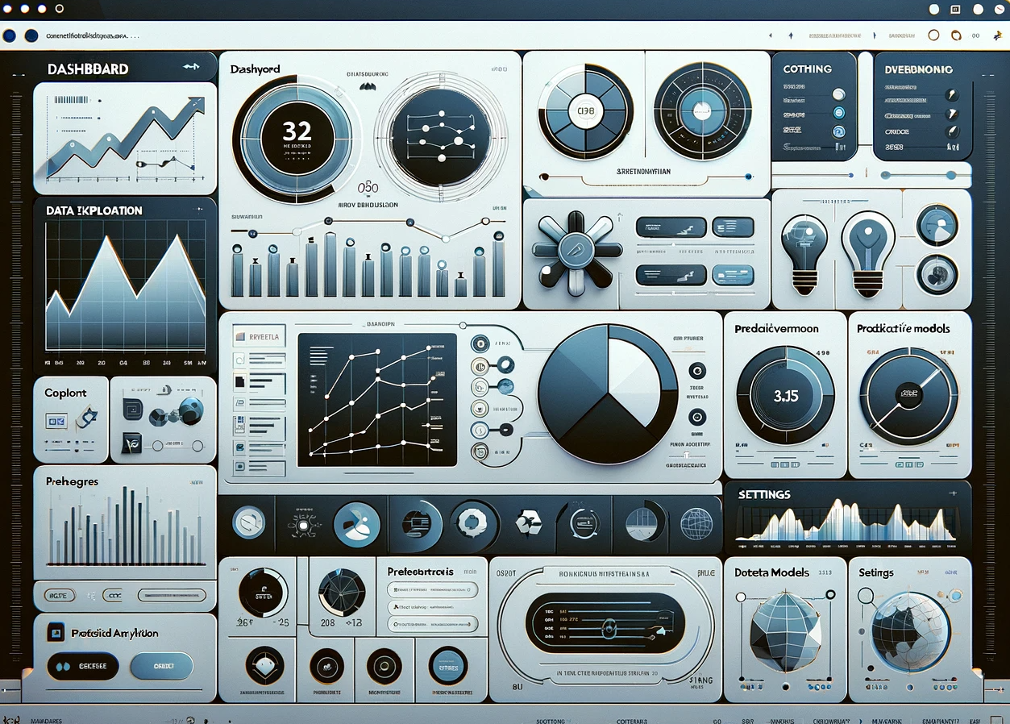
Data Analytics Tool Created an advanced data analytics tool for actionable insights Empowered the client to make informed business decisions, leading to cost savings

Slide 7
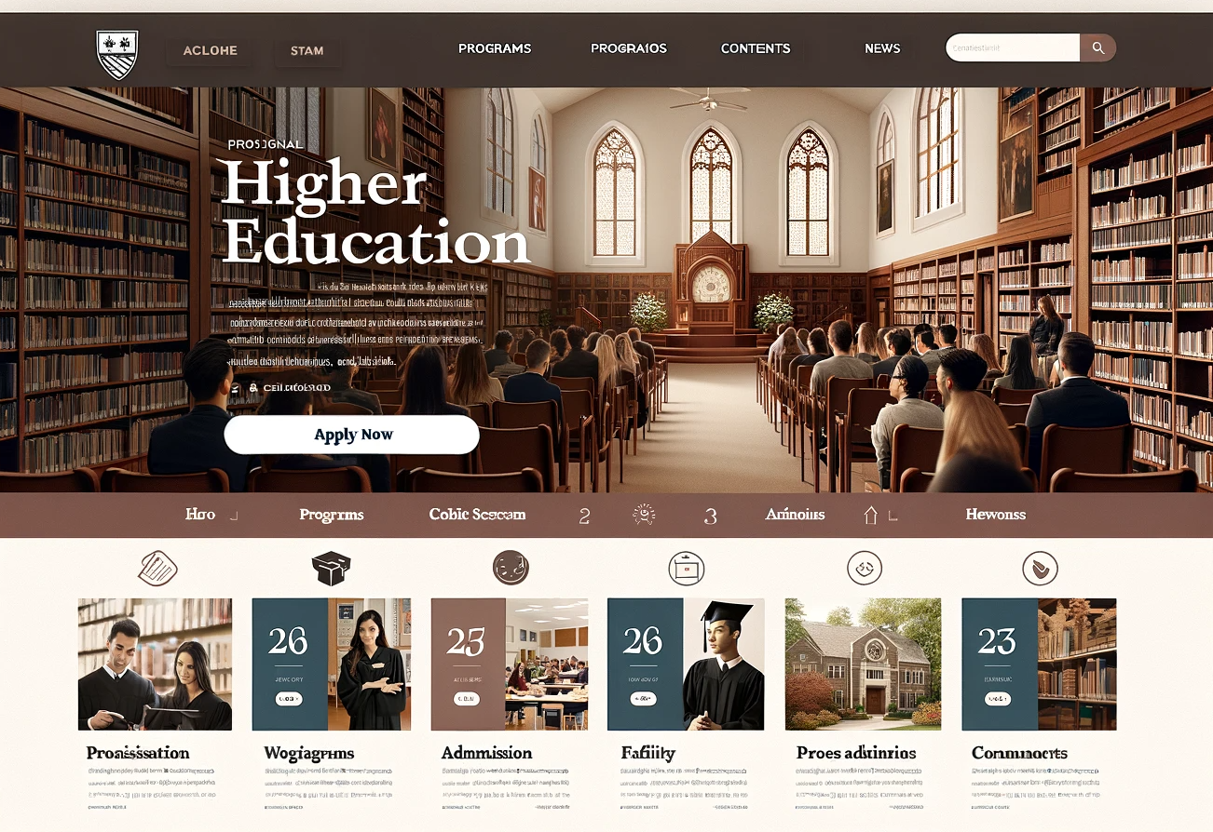
Education Technology Solutions Spearheaded projects in the education sector Enhanced learning experiences for users, fostering positive feedback

Slide 8
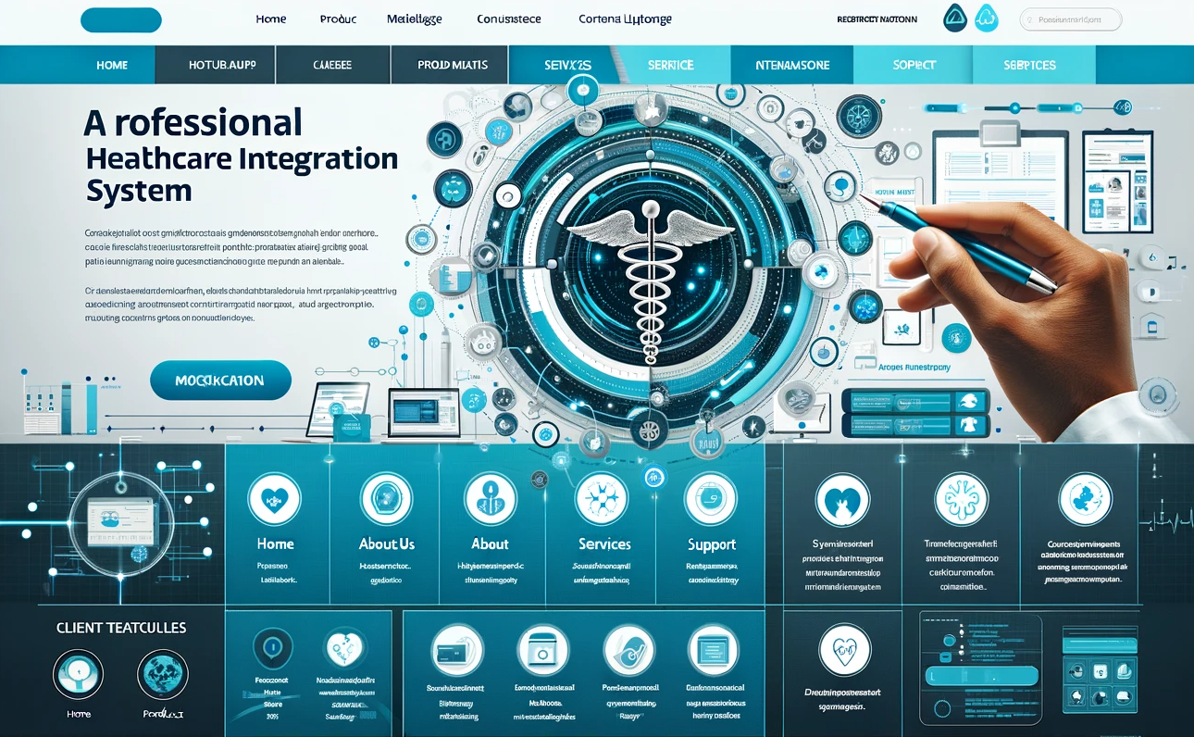
Healthcare Integration System Designed and implemented a secure healthcare integration system Streamlined patient data management, improving overall efficiency

Slide 9

Our Values

Slide 10
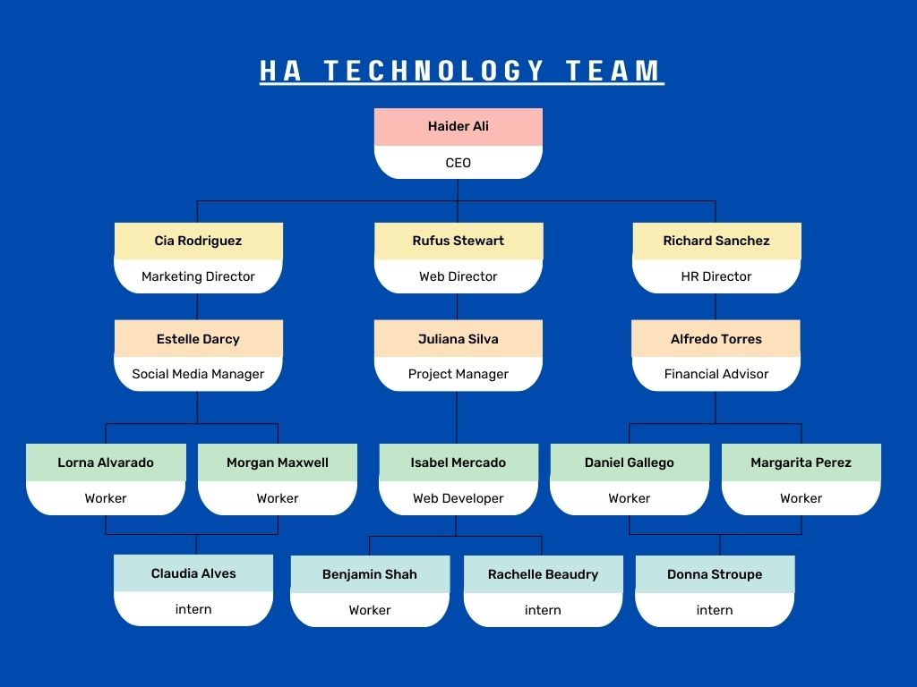
Our Team

Slide 11
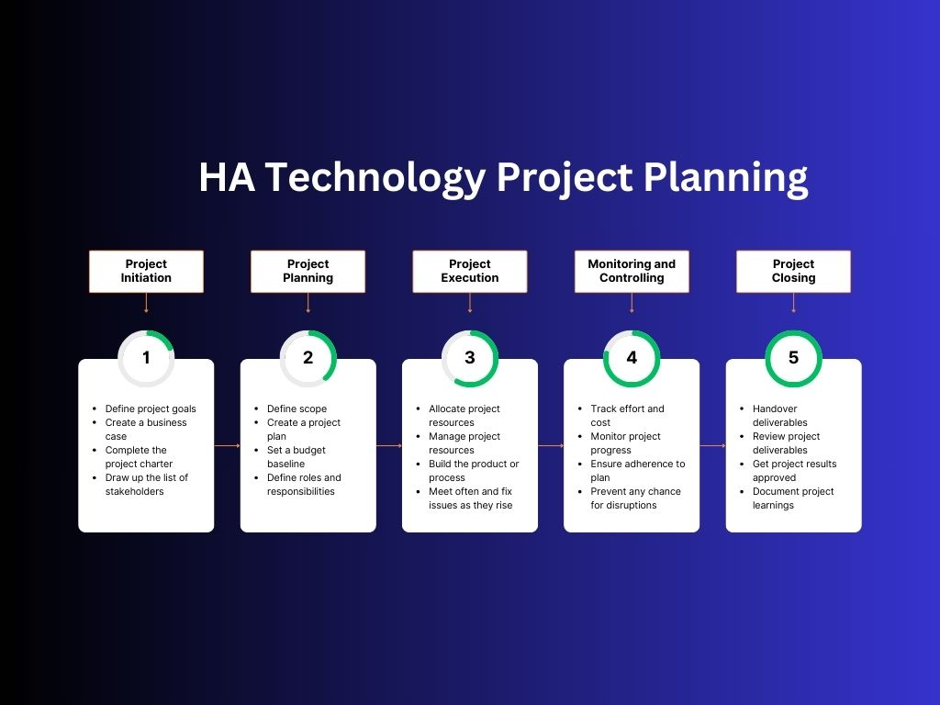

Slide 12
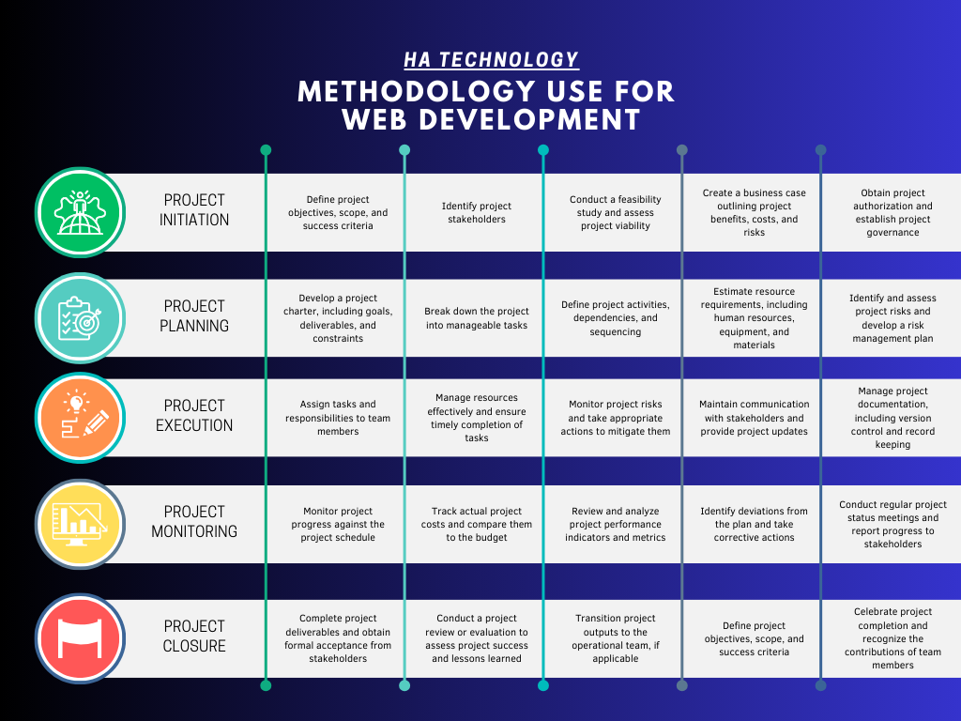

Slide 13
Contact us
EMAIL: HATECH22@GMAIL.COM
TELEPHONE:
+226-123 (4567)

